Slide 1


FINAL PROJECT
AMAZON SALES PERFORMANCE
Nguyễn Ngọc Điệp
học viên
TP HCM
josynguyen92@gmail.com
Project

Slide 2





Content
Introduction
Initial Analysis Plan
Data Storytelling & Visualization
Conclustion and insight
overview about project, data
1.Data cleaning
2.EDA
3. Deeper Analysis
1.Dashboard
2.sales trends.
3. Analysis
1.Conclusion
2. insights

Slide 3
Introduction
overview
Data source
From the accessible sales dataset, which contains information on product categories, sizes, fulfillment strategies, quantities sold, pricing, and customer types (B2B/B2C), the project's objective is to extract actionable insights. Optimizing operations, marketing, and sales strategies will be made easier with an understanding of trends in buyer behavior, fulfillment efficiency, and product performance.
Data sources use: https://www.kaggle.com/datasets/thedevastator/unlock-profits-with-e-commerce-sales-data/data Data descriptions:

Slide 4
Category:
Type of product. (String)
Size: Size of the product. (String)
Date: Date of the sale. (Date)
Status: Status of the sale. (String)
Fulfilment: Method of fulfilment. (String)
Style: Style of the product. (String)
SKU: Stock Keeping Unit. (String)
ASIN: Amazon Standard Identification Number. (String)
Courier Status: Status of the courier. (String)
Qty: Quantity of the product. (Integer)
Amount: Amount of the sale. (Float)
B2B: Business to business sale. (Boolean)
Currency: The currency used for the sale. (String)
Data detail
This dataset provides detailed insights into Amazon sales data, including SKU Code, Design Number, Stock, Category, Size and Color, to help optimize product profitability

Slide 5


Initial Analysis Plan

Slide 6
Steps
Handle missing data
Standardize data types
Remove duplicates

Slide 7
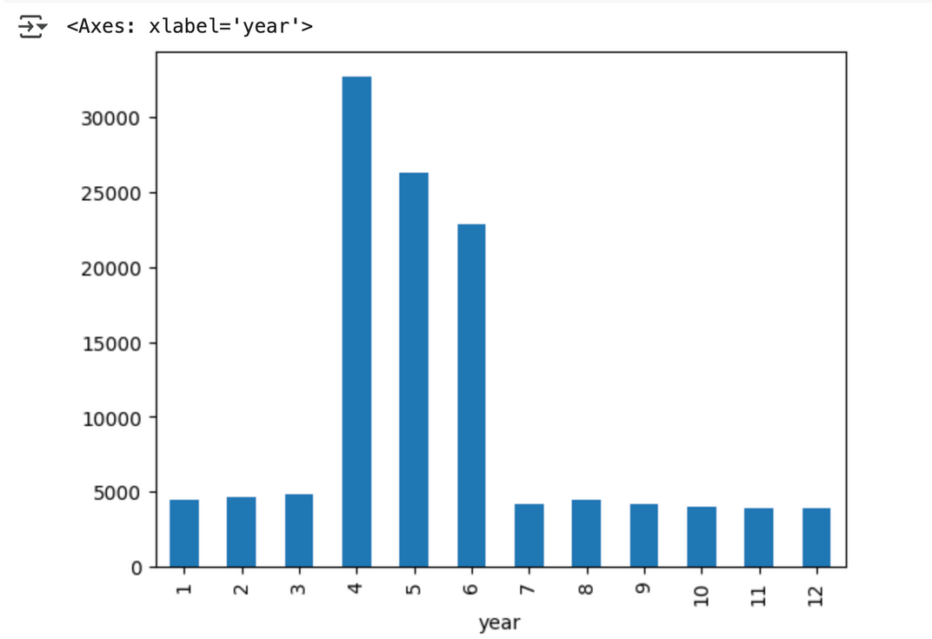
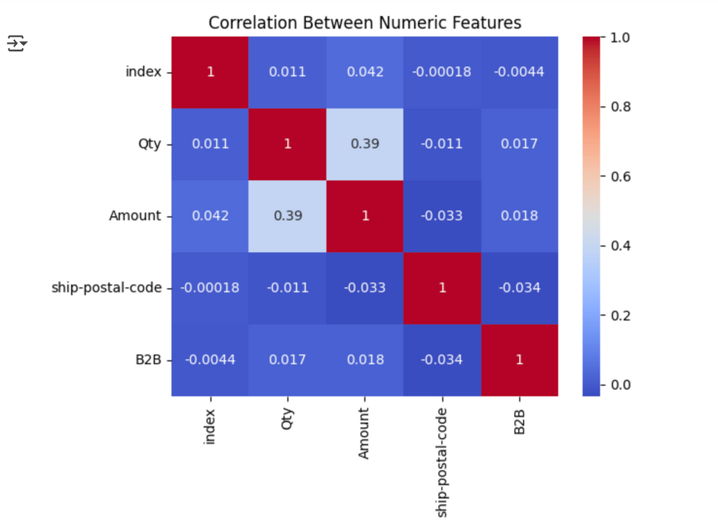
Exploratory Data Analysis (EDA)
Histogram
monthly sales amount
heatmap

Slide 8
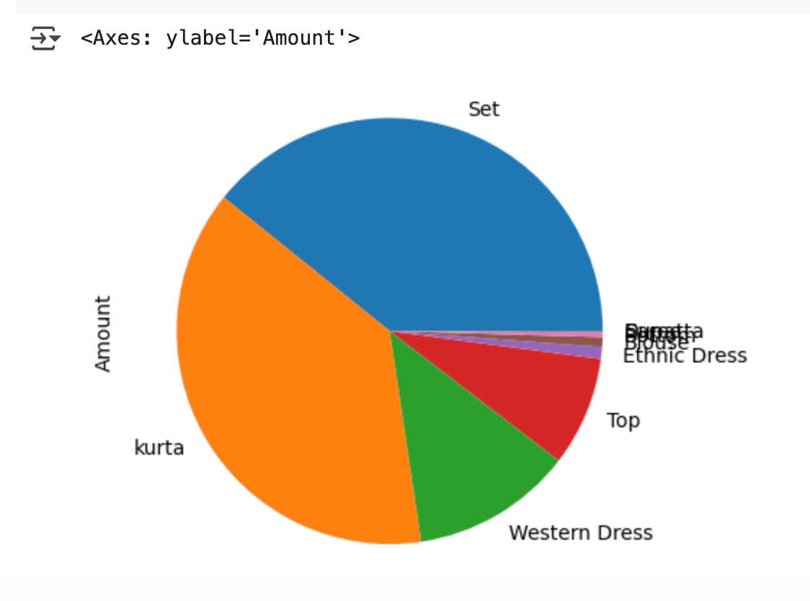
EDA
Pie chart :Category & amount

Slide 9
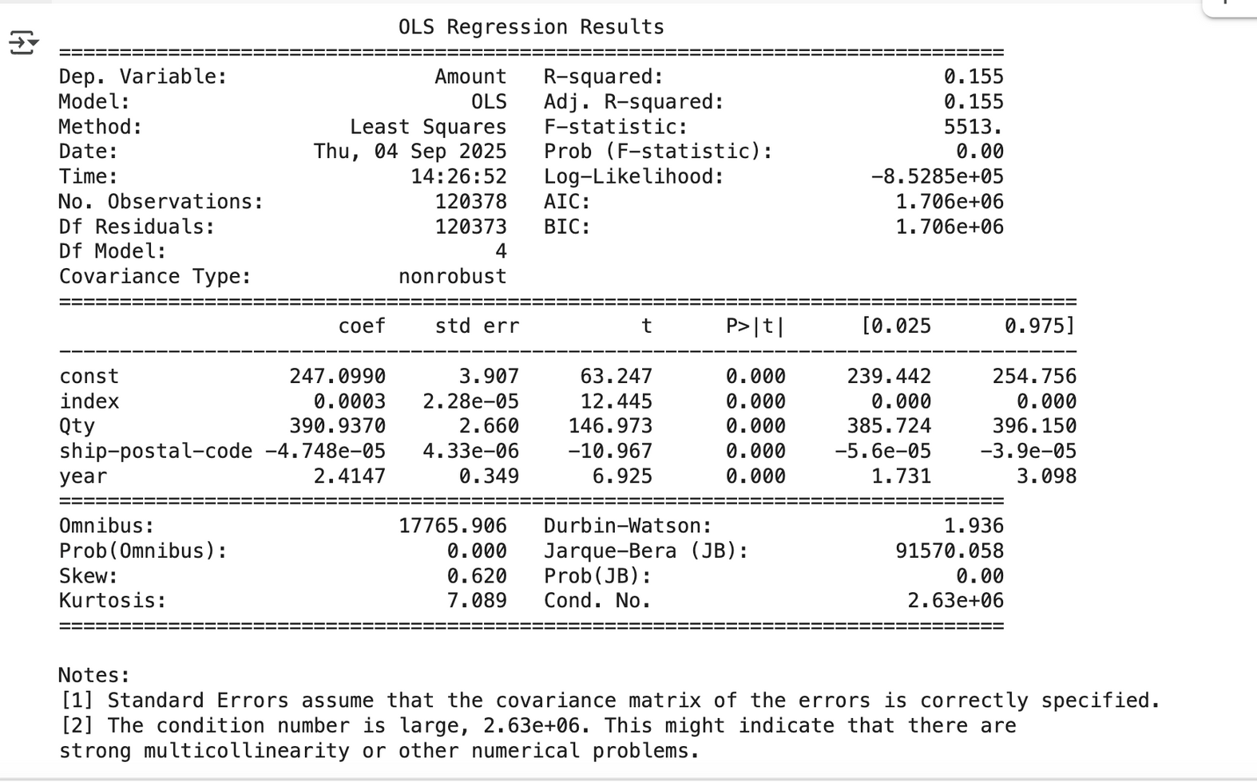
Modeling

Slide 10


Data Storytelling & Visualization

Slide 11
Result & insights
Result
Insights
1/ report show total sales amount reached $78.59Million
2/ the best ship-city have best sales amount is Bengaluru
3/April 2022 have the most sales formance during year of 2022
4/Category set and top are famous items on summer season
order with quantity 0-1000units are majority use and there less order over 2000 units, so AMZ should concentrate on orders quantity less 1000 units with set and top category
promote more summer items to improve sales performence of march

Slide 12


